Slide 1

Cyber Minutes
“A Year in Review "
12-27-2023 | Jonathan Montoya

Slide 2
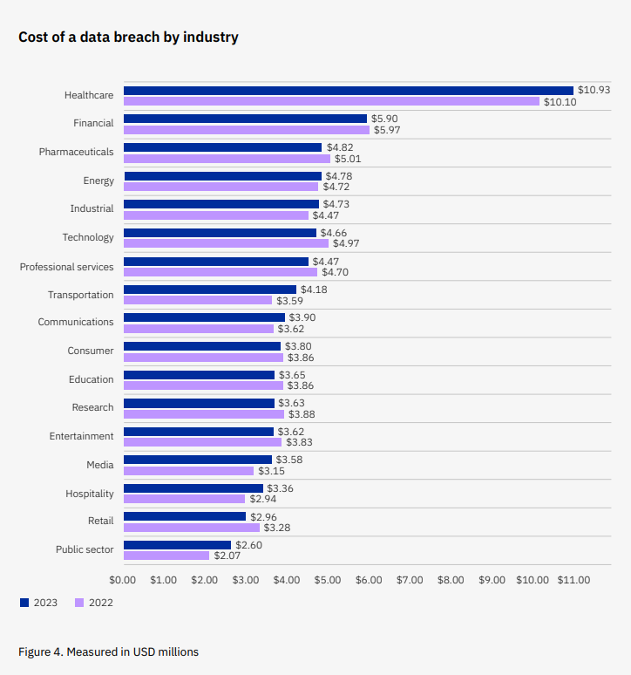
IBM Cost of Data Breach Report
All-time high of 4.45M average cost for a breach, a 15% increase since 2017
Data was collected from 553 breaches across 16 countries and 17 industries
Phishing was the most prevalent attack vector and the second most expensive at 4.76M
Employee training is part of the Top 3 cost mitigators to a breach with a difference of 33.9%
Only 51% of companies increasing security investments after a breach
82% of all breaches involved data stored in the cloud, often exposing multiple environments

Slide 3
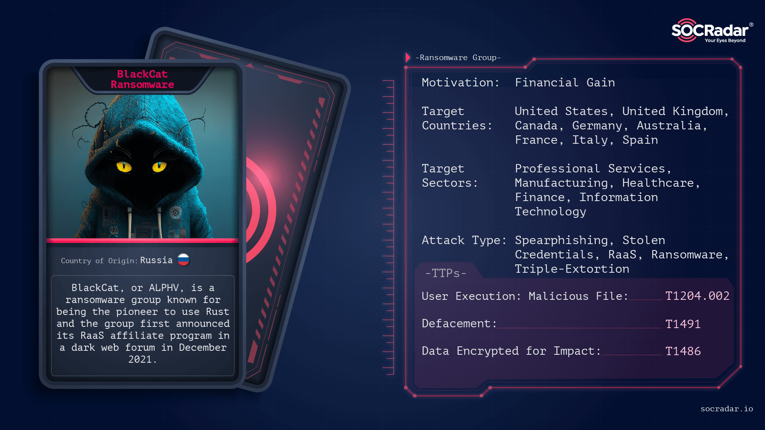

Decrypted
FBI released a free decryption tool for the BlackCat Ransomware
This decryption tool allows over 500 victims to recover their filed locked by the malware
BackCat RaaS has breached the networks of over 1,000 victims and has illegally earned close to 300M as of mid-2023
BlackCat representative told vx-underground reporter that law enforcement only had access to an old key
Other RaaS groups like LockBit were quick to capitalize on the news by offering those who were still in “negotiations” their infrastructure

Slide 4
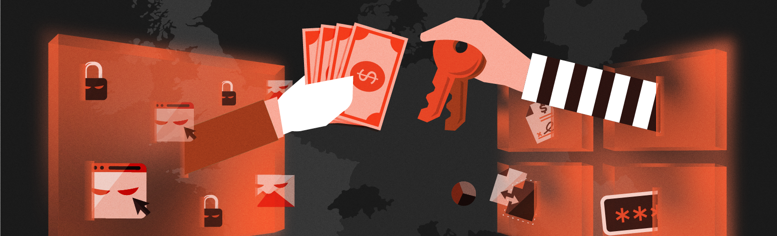
Has been observed attempting to steal user’s online banking account credentials
Estimated 50,00 infected user sessions across the globe
Web injection module delivered likely through phishing emails
Described as highly dynamic allowing it to adjust its flow of data to the C2 server or even erase traces of itself. This type of advanced code could possibly delay any immediate deployment, avoiding detection upon download
Will even display an error message after the user enters their credentials, saying something like this page is unavailable for the next 12 hours. This would give the attackers a window of opportunity to have free reign on the account
JavaScript Malware Infection

Slide 5

Sources
https://thehackernews.com/2023/12/fbi-takes-down-blackcat-ransomware.html
https://www.proofpoint.com/us/blog/security-awareness-training/2023-state-of-the-phish-findings-sneak-peek
https://www.microsoft.com/en-us/security/blog/2023/01/25/microsoft-security-reaches-another-milestone-comprehensive-customer-centric-solutions-drive-results/
https://www.varonis.com/blog/data-breach-statistics
https://www.ibm.com/reports/data-breach
https://www.crowdstrike.com/cybersecurity-101/cyberattacks/supply-chain-attacks/
https://thehackernews.com/2023/12/new-javascript-malware-targeted-50000.html

